Slide 1
SQL Project- Olympics data
Rupali Waghamare

Slide 2
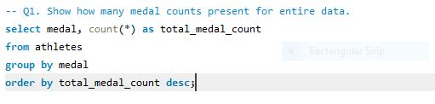
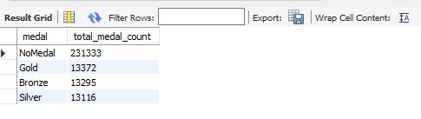
Q1. Show how many medal counts present for entire data
Result:-
.

Slide 3


-- Q2. Show count of unique Sports are present in olympics.
Result:-

Slide 4
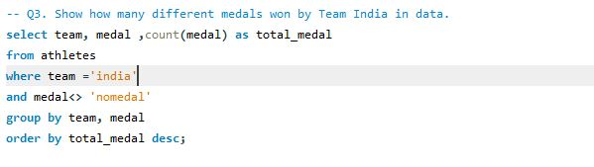

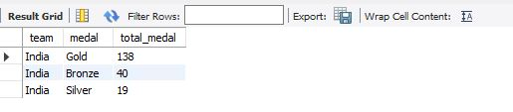
Q3. Show how many different medals won by Team India in data.

Slide 5
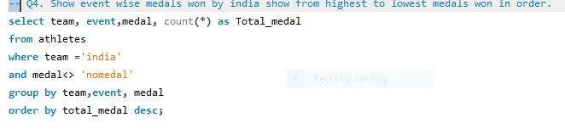

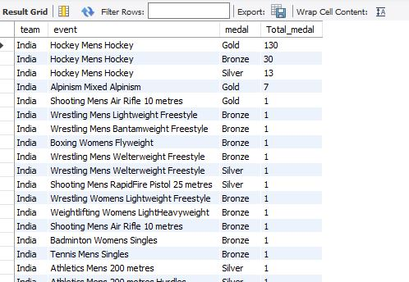
Q4. Show event wise medals won by india show from highest to lowest medals won in order.

Slide 6

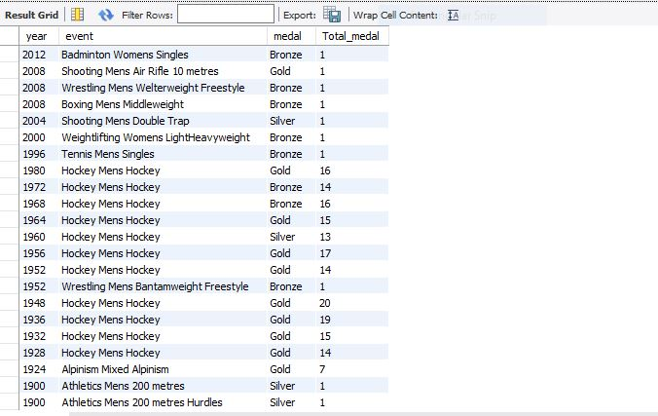
Q5. Show event and yearwise medals won by india in order of year.

Slide 7
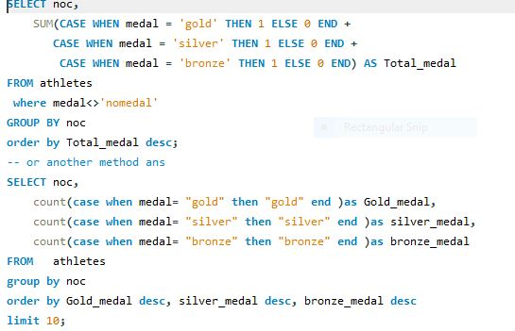
Q6. Show the country with maximum medals won gold, silver, bronze

Slide 8
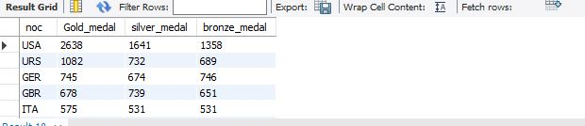

Slide 9
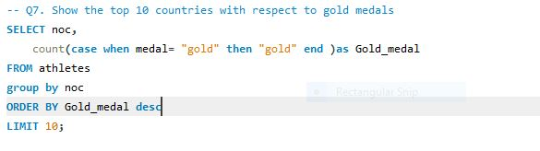
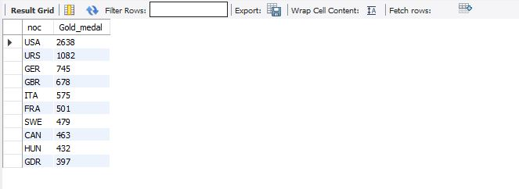
Q7. Show the top 10 countries with respect to gold medals

Slide 10
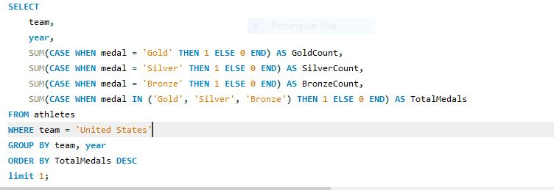
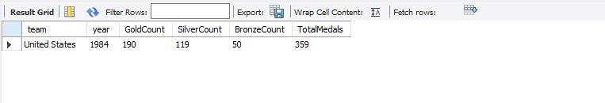
Q8. Show in which year did United States won most medals

Slide 11
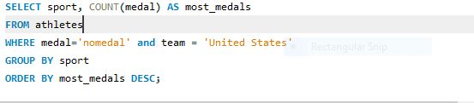
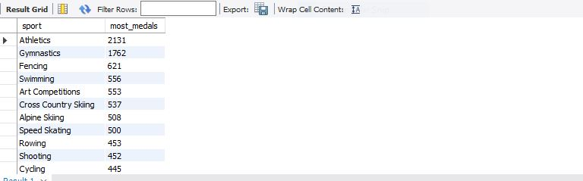
Q9. In which sports United States has most medals

Slide 12
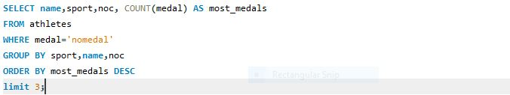
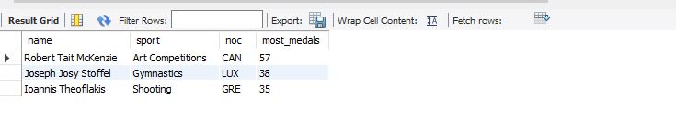
Q10. Find top 3 players who have won most medals along with their sports and country.

Slide 13
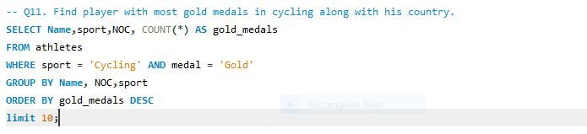
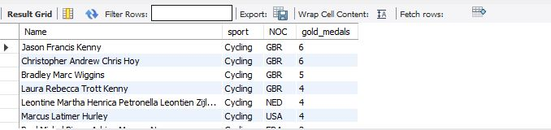
Q11. Find player with most gold medals in cycling along with his country.

Slide 14
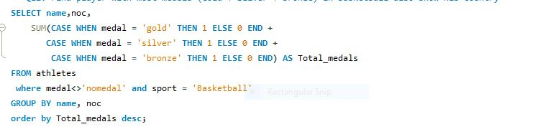

Q12. Find player with most medals (Gold + Silver + Bronze) in Basketball also show his country.

Slide 15
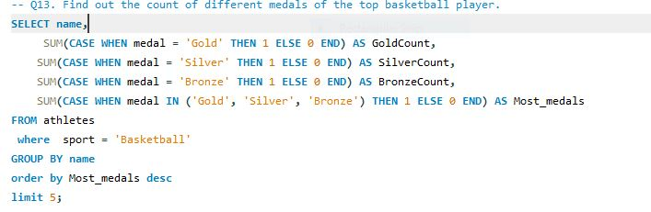
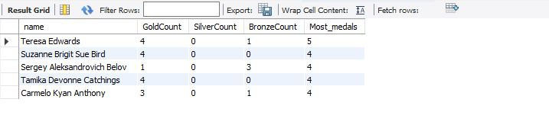
Q13. Find out the count of different medals of the top basketball player.

Slide 16
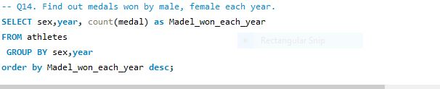
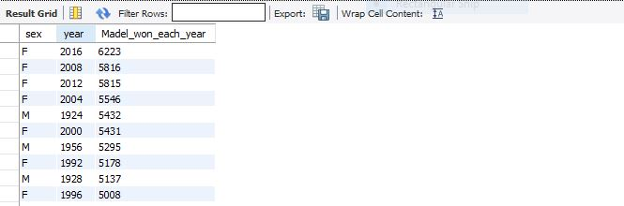
Q14. Find out medals won by male, female each year.

